Slide 1


3D Printing by
Selective Laser Sintering
Final Demo
Group 12
Luis Carrillo Electrical Engineer
Michael McMahon Photonic Engineer
Michael Rogatinsky Computer Engineer
Daniel Valledor Electrical Engineer
Group 12
3D Printing by Selective Laser Sintering
Notes:
Hello, my name is Daniel and this is the final demo for our senior project “3D Printing by Selective Laser Sintering”. The other engineers that will be speaking are Michael Rogatinsky, Luis Carrillo, and Michael McMahon

Slide 2
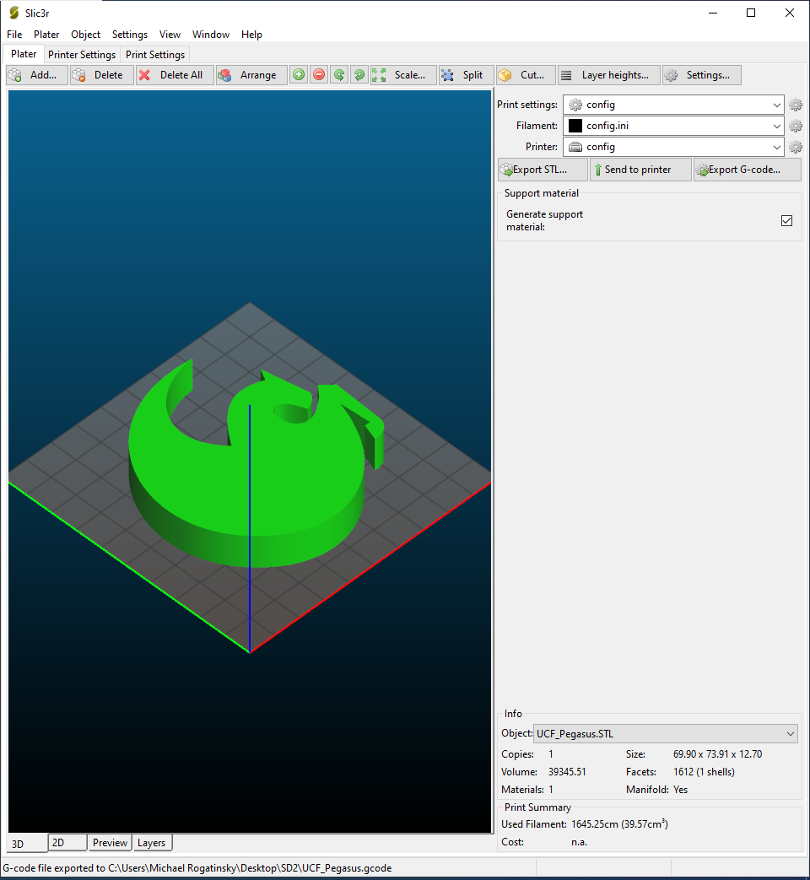
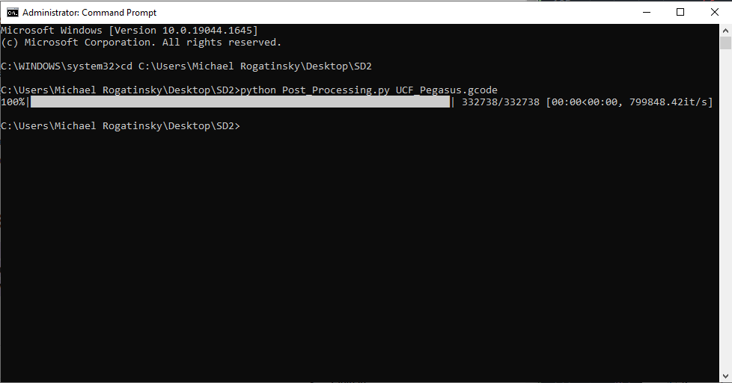
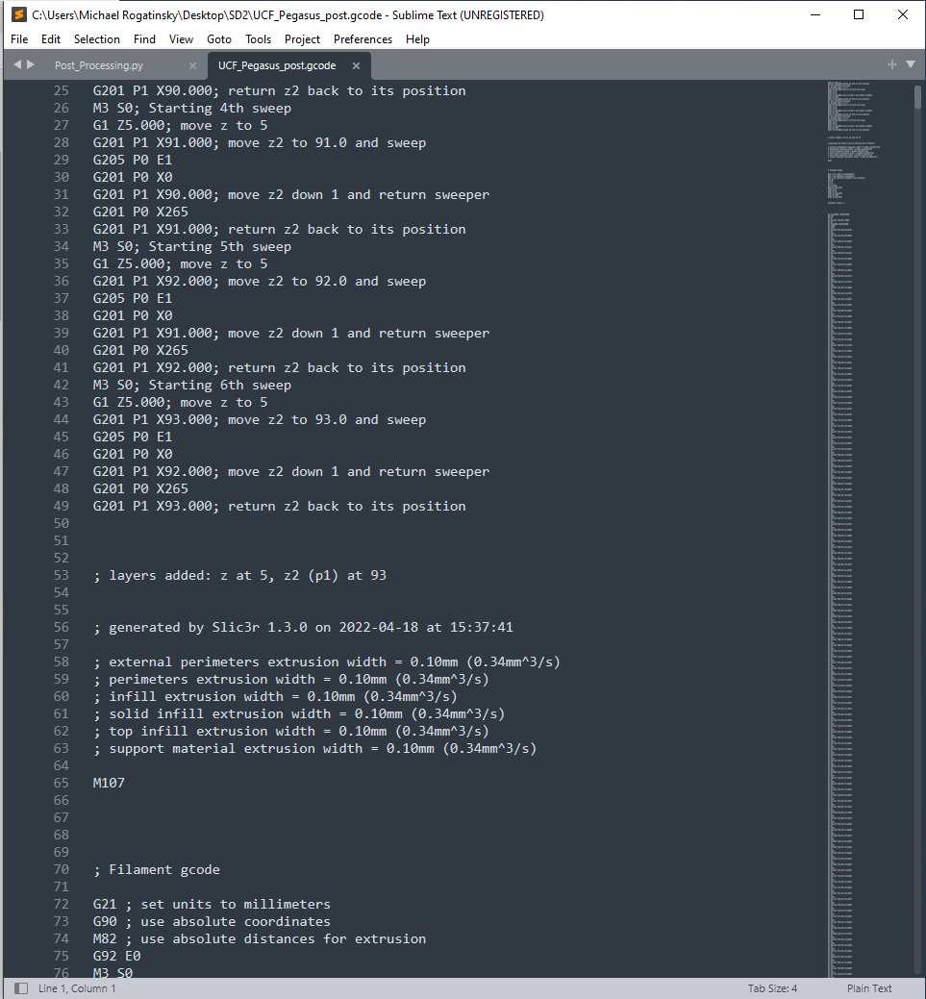
G-Code Development
Slicer
  We used the Slic3r slicer
  Build plate size of 100x100 mm
  Movement speed of 30 mm/s
  Layer size of 1.25 mm
Post Processer
  Written in python
  ~800,000 lines/second
  Converts extrusion to sintering commands
  Adds material in between layers
  Progress bar for more complex prints
Group 12
3D Printing by Selective Laser Sintering
Notes:
In order to generate the gcode we need, our 3d model must first be sliced in a slicer; we chose Slic3r for this because it worked well and allowed us to configure our printer specifications without creating an entirely new printer profile like cura would. In Slic3r, we set the bed size to 100X100 mm with a movement speed of 30 mm/s and a layer height of 1.25 mm in order to match our printer and powder specifications.
Once the model was sliced and the gcode generated, we could pass it into our postprocessing script to make the gcode more suitable for an sls printer. Extrusion commands get changed to laser power commands with the laser being turned off in between movements and for travel movements, material is added in between layers instead of during layers, and just about any other modifications can be made too by modifying the script as needed. The script is written in python for ease of use and modification, and can process about 800,000 lines of gcode per second but a progress bar is also provided for more complex prints that may take longer to process.

Slide 3
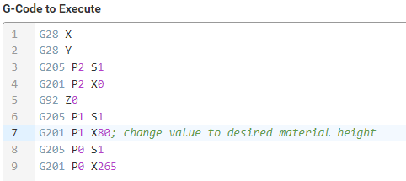
Homing Sequence
Home X and Y axes
Home Z axis and set it to position 0
Home the reservoir and move it to the desired height for the build
Home the sweeper mechanism
Group 12
3D Printing by Selective Laser Sintering
Notes:
To ensure that the printer is properly calibrated before each print, the homming sequence is used to properly set all motor locations. First the x and y axes are homed and left in there park position (-5, -49).
Then the z axis is homed and set to its 0 position, fallowed by the reservoir which is moved to the desired height to not use exces powder, and finaly the sweeper mechanism.
After all this, the reservoir can be filled with powder for the print withought needing to worry about measuring out the proper amount.

Slide 4
Foundation Powder Delivery
Group 12
3D Printing by Selective Laser Sintering

Slide 5
Recording
Group 12
3D Printing by Selective Laser Sintering

Slide 6
First Layer Sintering
Group 12
3D Printing by Selective Laser Sintering

Slide 7
Recording
Group 12
3D Printing by Selective Laser Sintering
Notes:
The following is the video of Test 1. After uploading the gcode, we initiated the print. The first segment of the video shows the calibration sequence of the x-y scanner. After calibration, the scanner will begin to draw the initial layer. The test also demonstrates that the power module can successfully convert wall power into regulated DC voltage and supply the necessary DC power for complete stepper motor operation. The test will continue until it reaches the midpoint of the second layer. From there, we will compare the final results with the “Smiley” model.

Slide 8
Powder Delivery after Sintering
Group 12
3D Printing by Selective Laser Sintering

Slide 9
Recording
Group 12
3D Printing by Selective Laser Sintering
Notes:
After sintering each layer, the build plate moves down 1.2 mm and the powder plate moves up 1.2 mm. The sweeper delivers a new layer of powder to the build area without disturbing the sintered layer. The process of sintering and powder delivery continues until the print is complete.

Slide 10
Removing the Print
Group 12
3D Printing by Selective Laser Sintering

Slide 11
Recording
Group 12
3D Printing by Selective Laser Sintering
Notes:
Once the print for smiley completed, we carefully removed the print from the print area. As shown in the video, the print stayed intake once removing it. This marks our first successful print with our 3D printer.

Slide 12
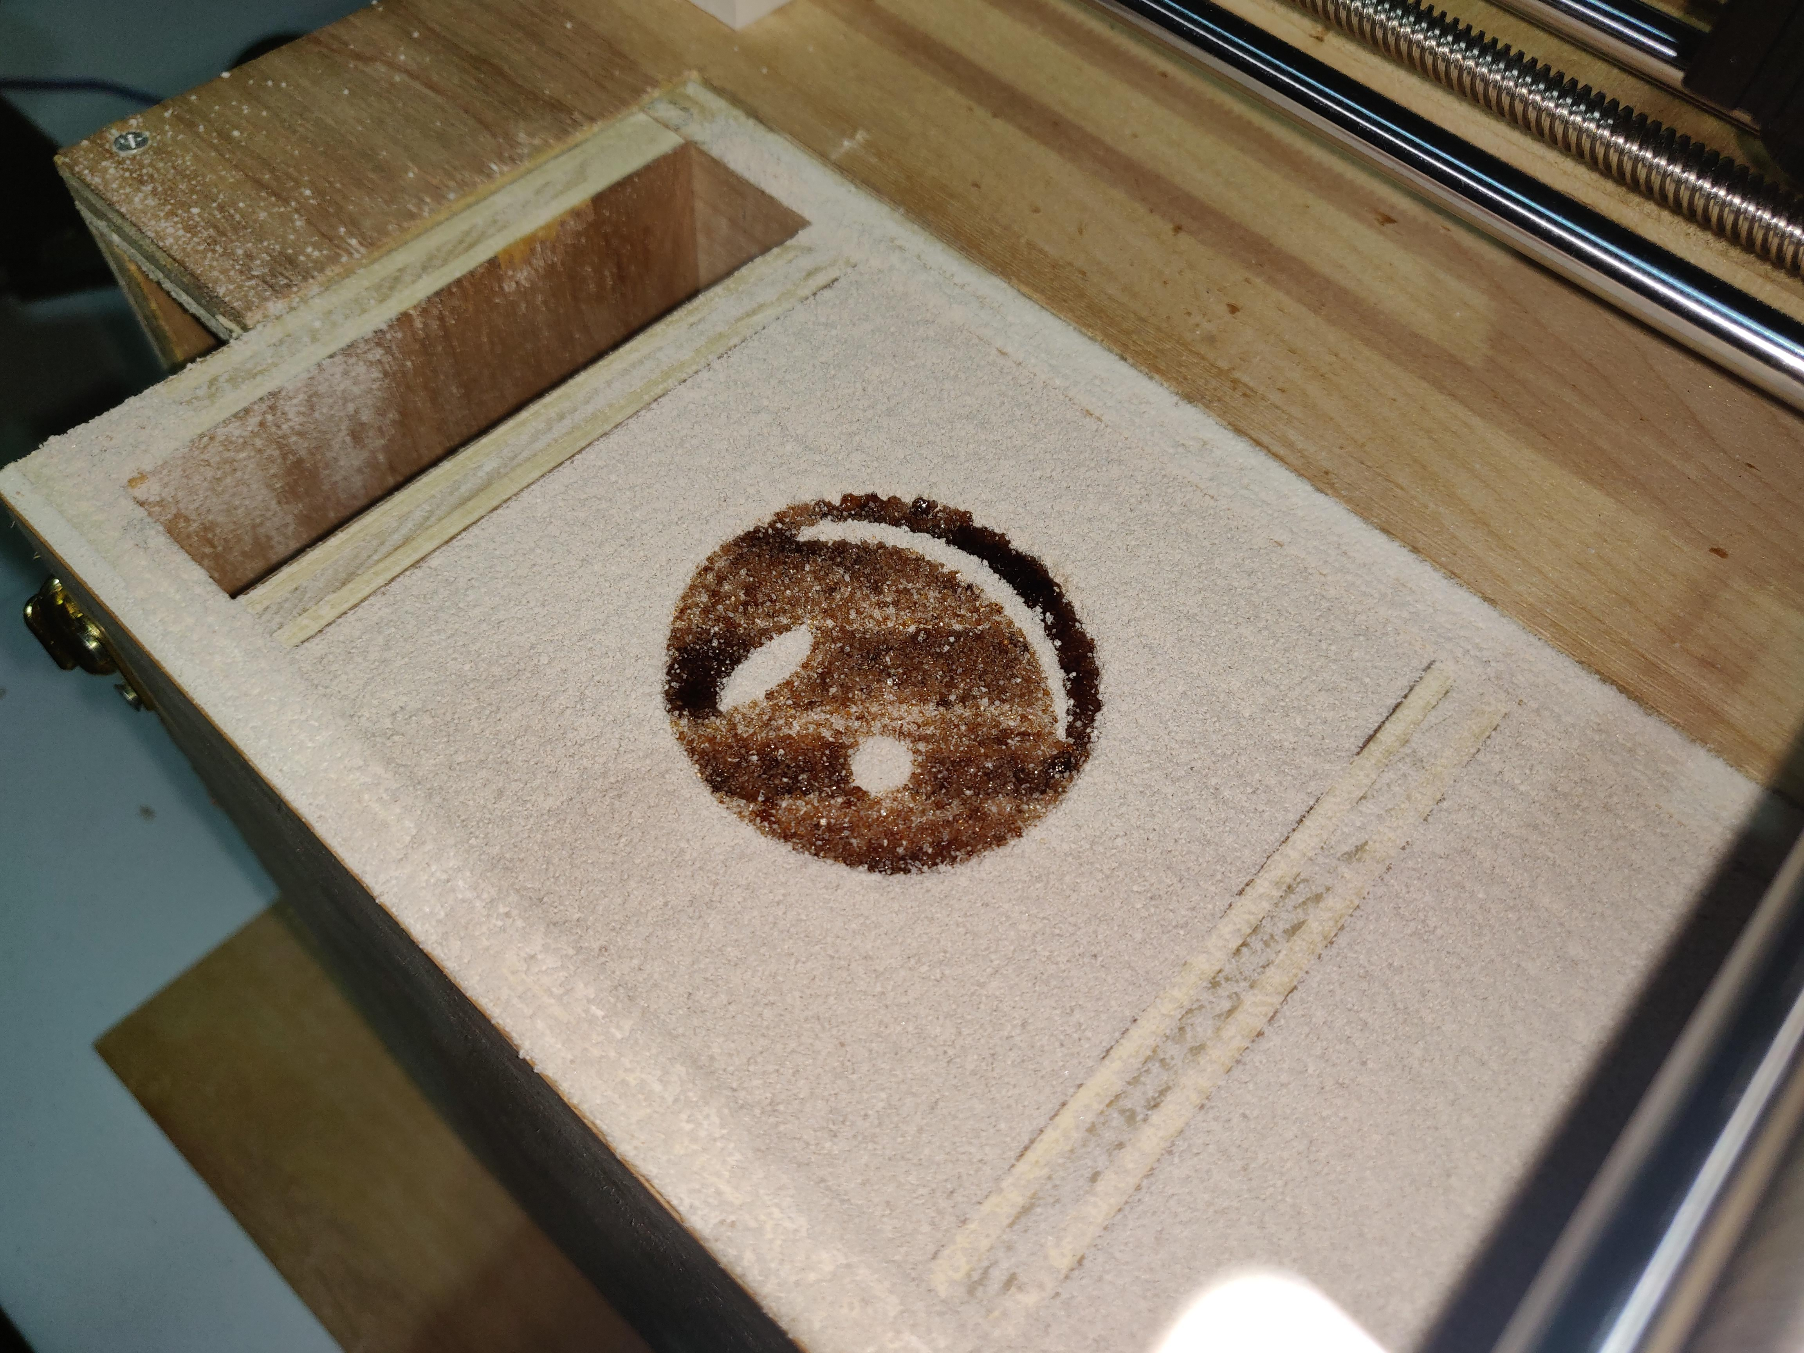
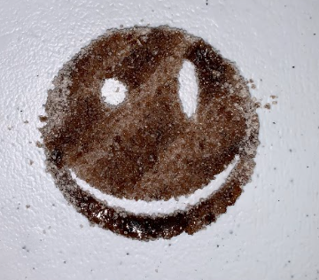
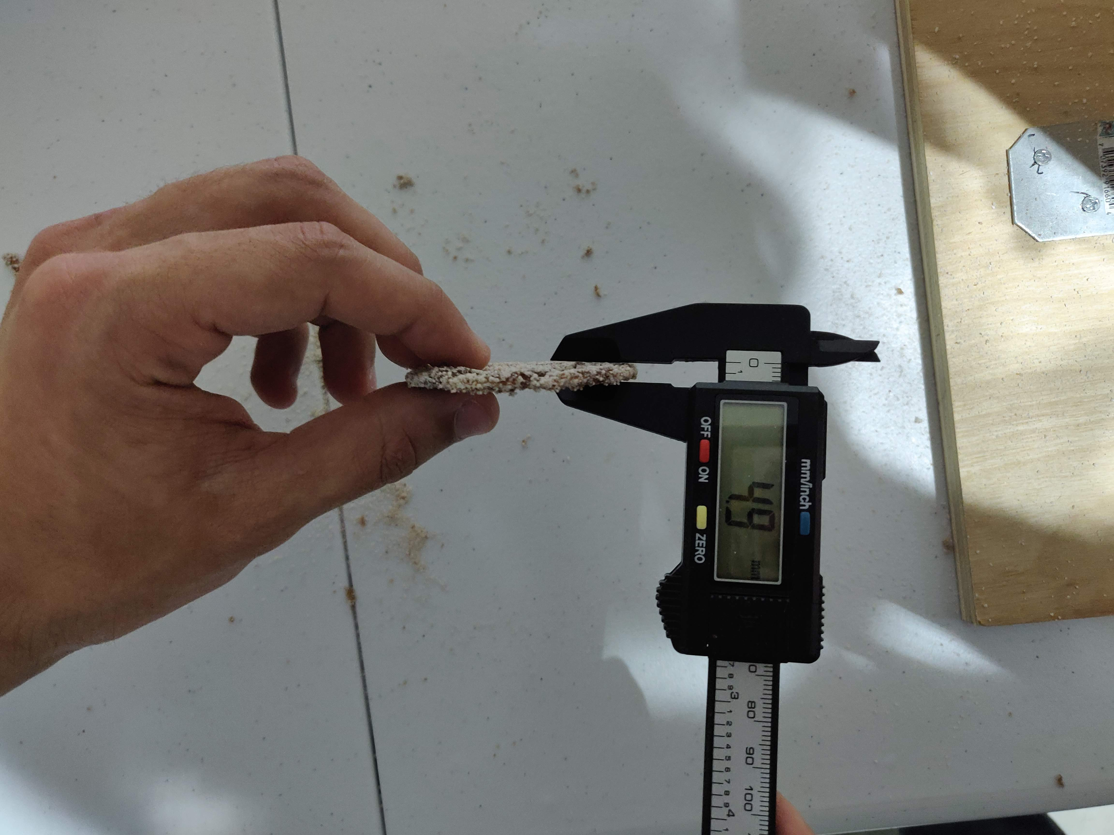
Smiley Results
(a)
(b)
(c)
Group 12
3D Printing by Selective Laser Sintering
Notes:
The following are the results from the Smiley Print
In Figure A, we can see smiley in the print area immediately after the completion of the print.
Figure B shows smiley after being removed. One thing to note is the distinct diagonal lines. This is primarily due to the constant laser power. In areas where the lines were shorter, it heated the powder more causing it to slightly melt. The degree at which the powder melted is strongly correlated to the line length
Figure C shows the thickness of Smiley. We measured the thickness to be 4.9 mm. Smiley was modeled to be 2.4 mm therefore there was 2.5 mm of unintended penetration. From empirical evidence, we can design around this value before printing.

Slide 13
Mechanical Instability and Issues
Group 12
3D Printing by Selective Laser Sintering

Slide 14
Recording
Group 12
3D Printing by Selective Laser Sintering
Notes:
Some issues with high scanning speeds were encountered. In this video clip, the printer is attempting to print a square with diagonal line exposures. The first half of the square started off well. However, as the print progressed, the arms holding the laser module began to resonate with each other, and the exposed area seemed to no longer progress. Instead, the laser module seems to scan over the same area until the resonance becomes so great such that the printer arms flail wildly. Thankfully, no mechanical failures occurred due to the resonance, but the model was not successfully printed with diagonal exposures.

Slide 15
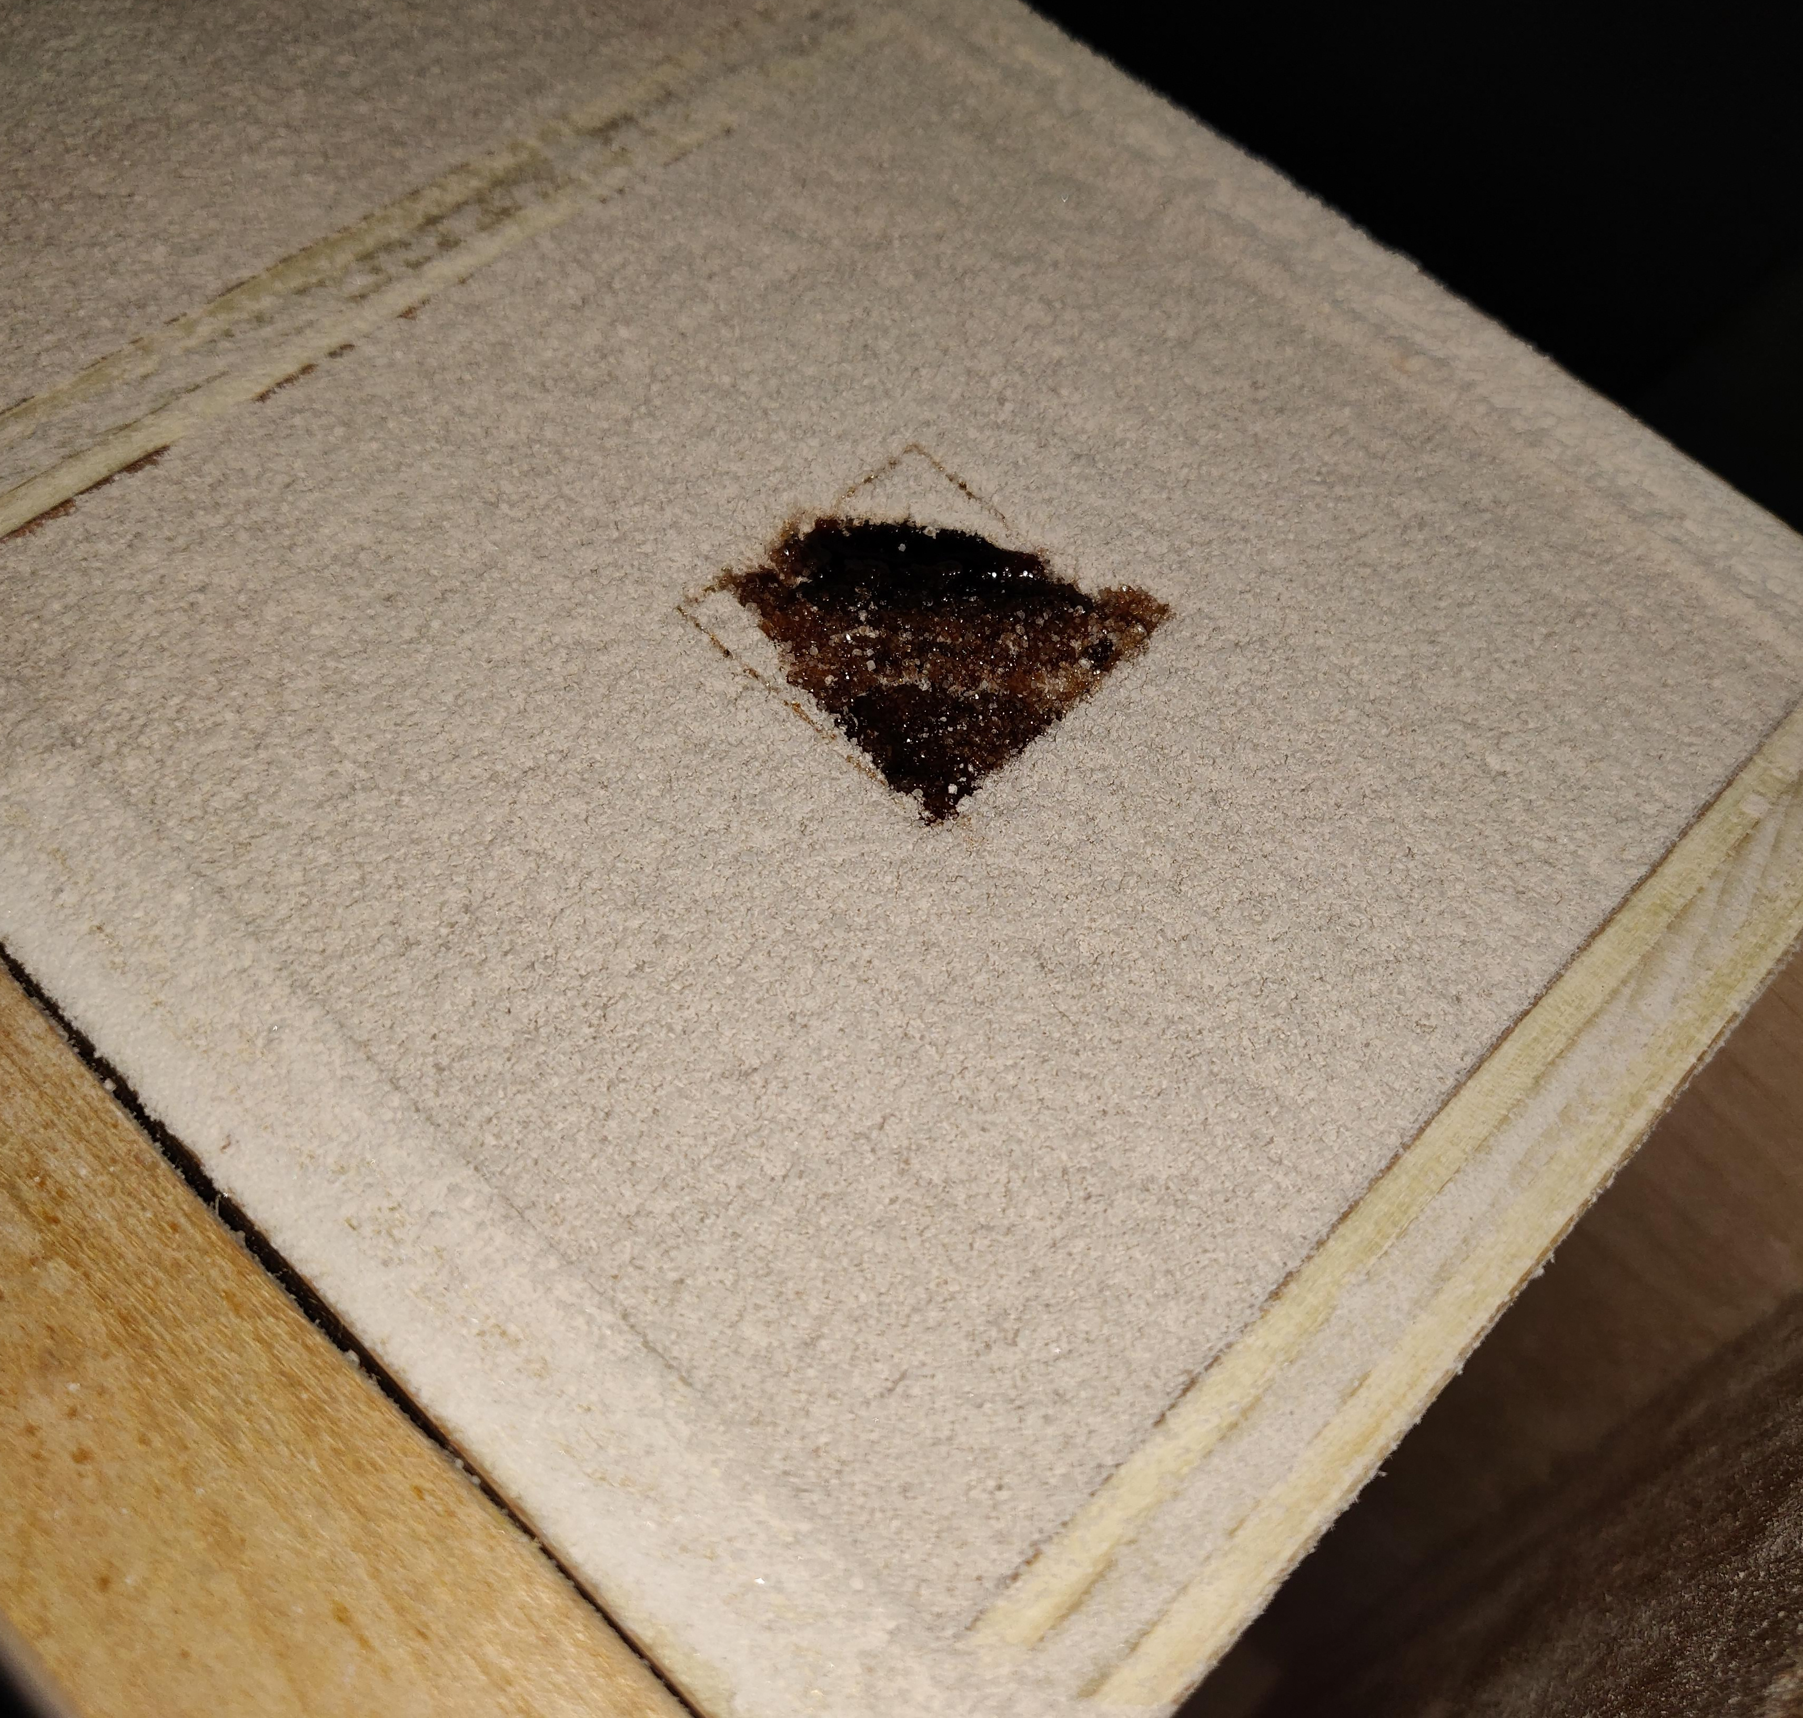
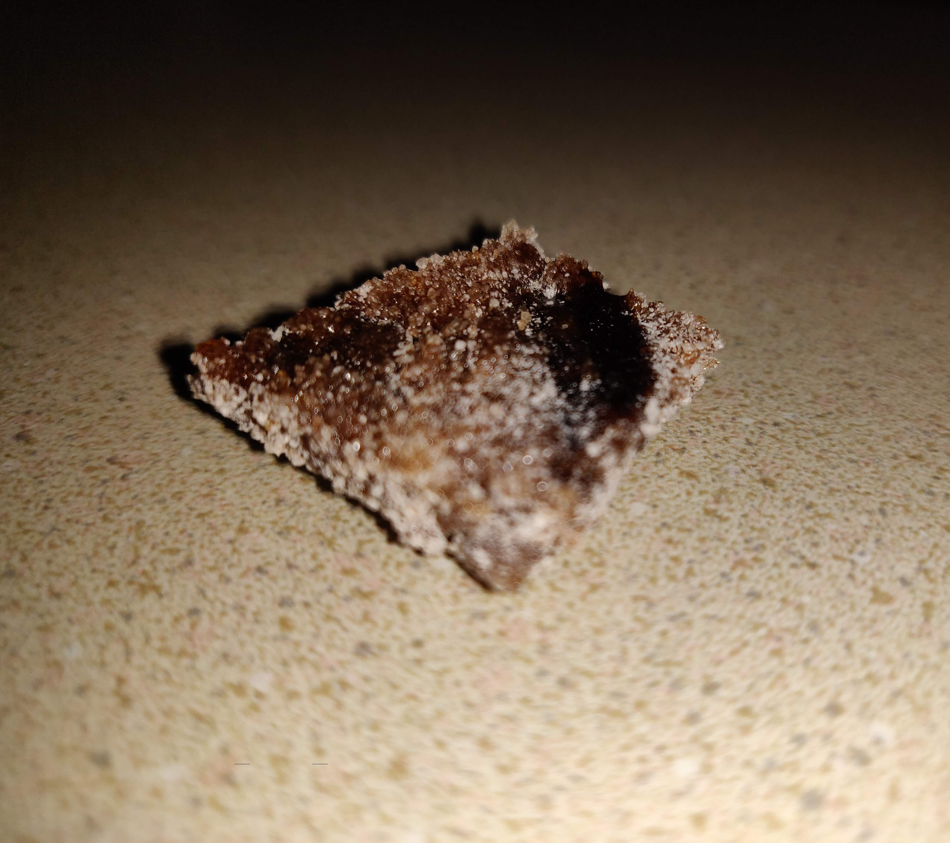
High Speed Square Results
(a)
(b)
Group 12
3D Printing by Selective Laser Sintering
Notes:
Here are the results of the high speed scanning test. In figure (a), the initial outline of the square can be seen in the tea mix. Figure (b) shows the resulting print extracted from the print bed. While mechanically strong, the print has excessively burnt areas, specifically where the resonance peaked.

Slide 16
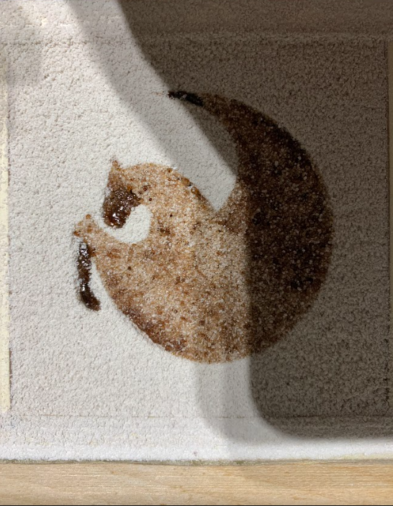
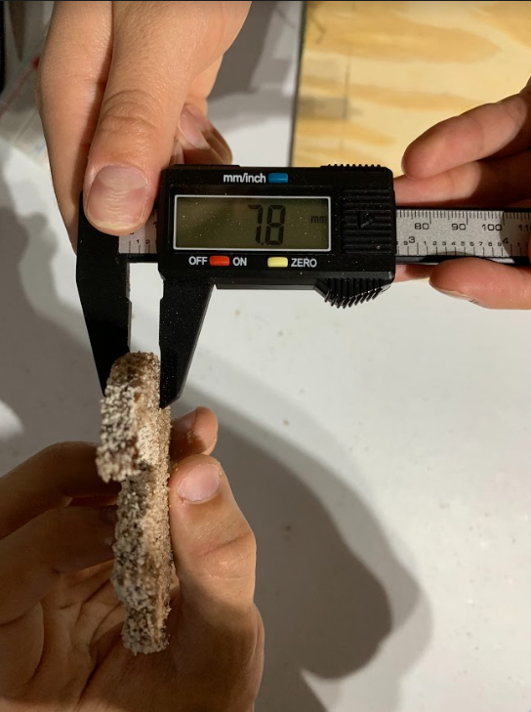
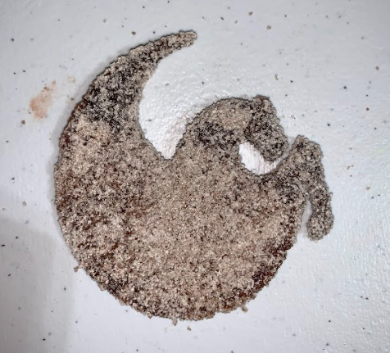
UCF Pegasus
(a)
(b)
(c)
Group 12
3D Printing by Selective Laser Sintering
Notes:
As a final test of reproducibility, we decided to print the UCF Pegasus logo with the raspberry tea mix. The test print came out extremely well, with all parts remaining intact. This is in part due to the larger dimensions of the logo; we added two more layers of thickness to have four layers total. Printing and exposure characteristics are similar to the Smiley model. Parts of the Pegasus logo experienced more local exposure than others, which resulted in melted areas of the print.

Slide 17
Thank You
Group 12
3D Printing by Selective Laser Sintering
Notes:
In conclusion, our prototype was a success. With more time and testing, we would be able to dial in the process parameter for proper SLS 3D printing. Thank you for watching our final demo.

